Slide 1

Watson Speech to Text
https://www.ibm.com/watson/
https://www.ibm.com/watson/developercloud

Slide 2
Speech To Text Demo
https://speech-to-text-demo.mybluemix.net/

Slide 3
STT Visão geral
Conversão de voz em texto
Acessível via REST ou WebSocket (Fluxo contínuo)
8 Línguas suportadas
Audio em OGG, FLAC, WAV, PCM, WebM
Maximum alternatives and interim results
Profanity filtering (US English)
Speaker labels (beta)
Word alternatives (beta), confidence, and timestamps
Smart formatting (beta)

Slide 4
Línguas Suportadas
Brazilian Portuguese
French
Japanese
Mandarin Chinese
Modern Standard Arabic
Spanish
UK English
US English

Slide 5
Documentação
https://www.ibm.com/watson/developercloud/doc/speech-to-text/index.html

Slide 6
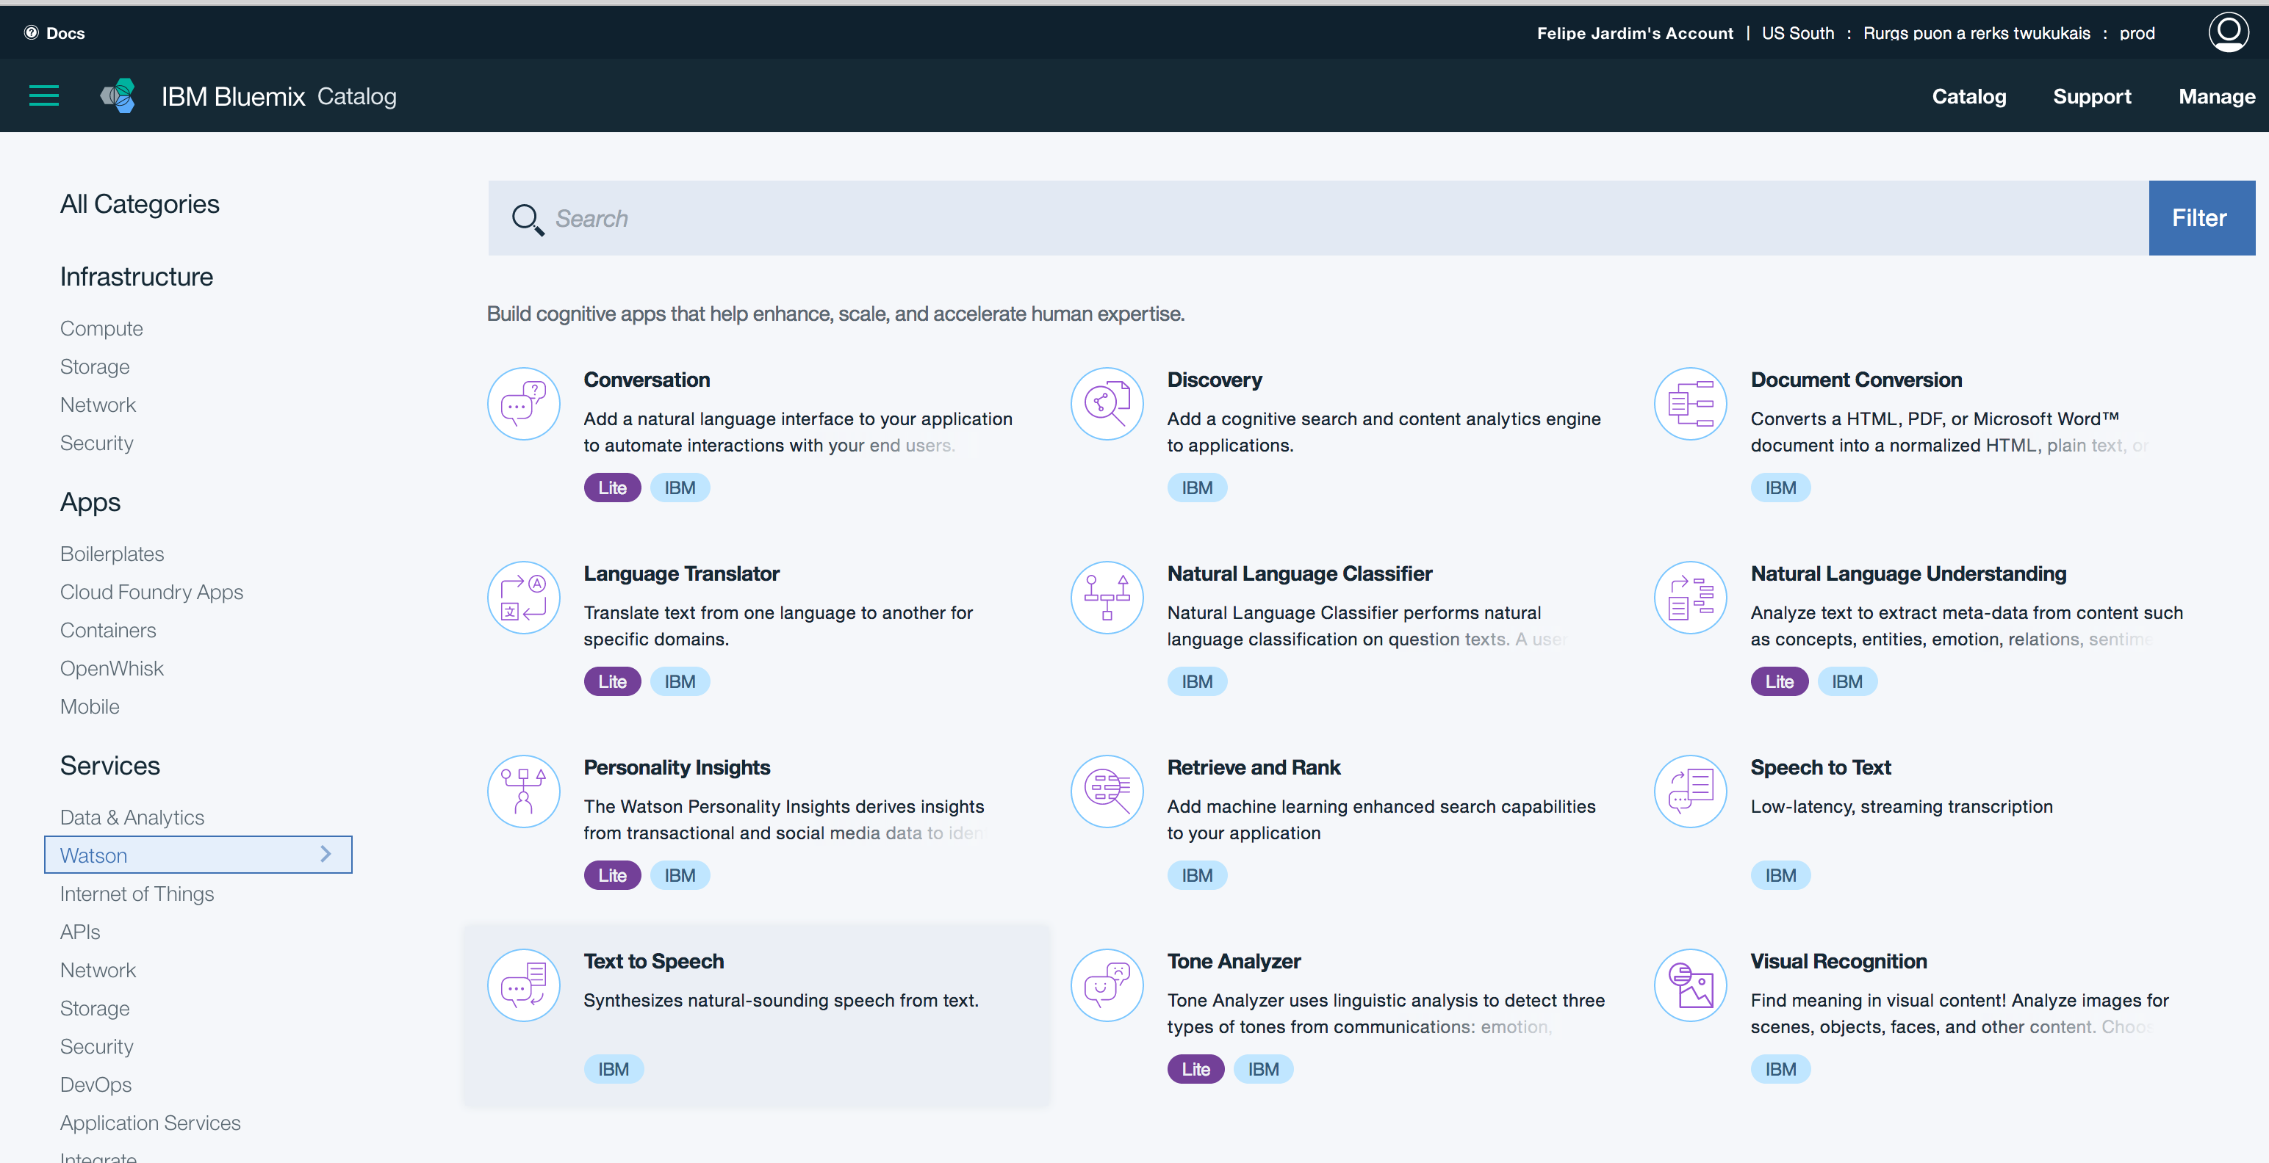
Criar Instância do STT

Slide 7
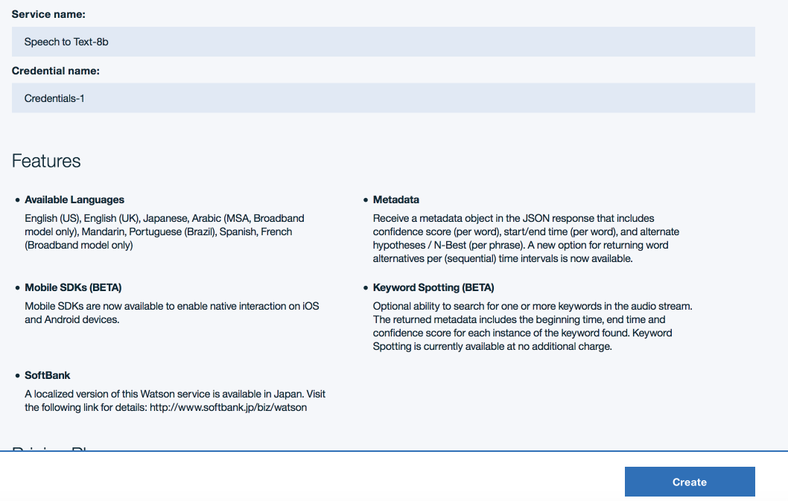
Criar Instância do STT

Slide 8
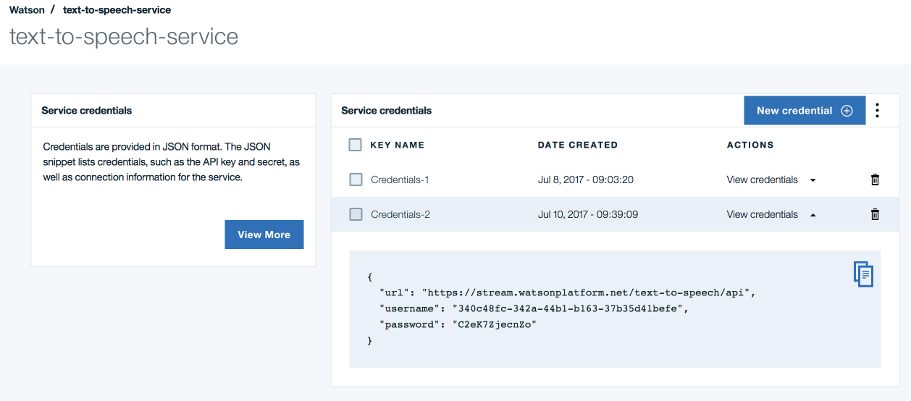
Credenciais de acesso

Slide 9
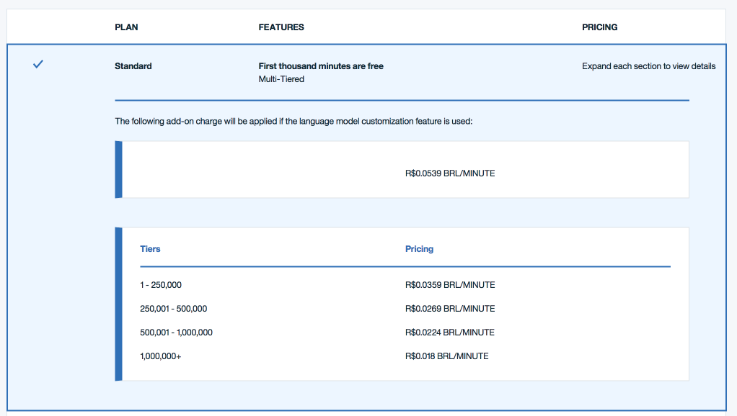
Preço

Slide 10
Interface HTTP REST
POST /recognize
POSThttps://stream.watsonplatform.net/speech-to-text/api/v1/recognize?model=pt-BR_BroadbandModel
content-type:audio/wav
body: audio_file.wav

Slide 11
Interface HTTP REST
Resposta:
{
"results": [{"alternatives": [
{ "confidence": 0.986,
"transcript": "isso é um teste"}],
"final": true}],
"result_index": 0
}

Slide 12
Interface HTTP REST
Parâmetros:
content-type – formato do audio enviado
model: o modelo (lingua) utilizado (ex. pt-BR_BroadbandModel)
body:conteúdo do arquivo de audio
inactivity_timeout: intervalo de silencio para interormper a conexão. Padrão 30 segundos. -1 para infinito
keywords: palavras para serem localizadas na transcrição
keywords_threshold : valor de confiança para identificar keywors (entre 0 e 1)
max_alternatives: Máximo de alternativas a serem retornadas (default 1)
word_alternatives_threshold: valor de confiança (entre 0 e 1) para alternativas
word_confidence: (true/false) retorna o valor de confiança para cada palavra
timestamps: (true/false)informa o timestamp de cada palavra
profanity_filter: (true/false) filtra palavras de baixo calão e subistitui por asterisco(US English)
smart_formatting(true/false): Conversão de números, data, dinheiro (US English)
speaker_labels: Identifica participantes (en, es, jp Only)

Slide 13
Interface HTTP REST
Content-types aceitos:
audio/flac
audio/l16
audio/wav
audio/ogg
audio/ogg;codecs=opus
audio/ogg;codecs=vorbis
audio/webm
audio/webm;codecs=opus
audio/webm;codecs=vorbis
audio/mulaw
audio/basic

Slide 14
Interface HTTP REST
Valores aceitos para model:
ar-AR_BroadbandModel
en-UK_BroadbandModel
en-UK_NarrowbandModel
en-US_BroadbandModel (the default)
en-US_NarrowbandModel
es-ES_BroadbandModel
es-ES_NarrowbandModel
fr-FR_BroadbandModel
ja-JP_BroadbandModel
ja-JP_NarrowbandModel
pt-BR_BroadbandModel
pt-BR_NarrowbandModel
zh-CN_BroadbandModel
zh-CN_NarrowbandModel

Slide 15

Interface WebSockets
WebSockets: Comunicação bidirecional sobre sockets TCP
wss://stream.watsonplatform.net/speech-to-text/api/v1/recognize
APP
Socket
wss://

Slide 16
Interface WebSockets
WebSockets URI:
wss://stream.watsonplatform.net/speech-to-text/api/v1/recognize?watson-token=<auth-token>&model=pt-BR_BroadbandModel
Como obter um token:
GET https://stream.watsonplatform.net/authorization/api/v1/token?url=https://stream.watsonplatform.net/text-to-speech/api
Detalhes sobre Tokens: https://www.ibm.com/watson/developercloud/doc/common/getting-started-tokens.html

Slide 17
Interface WebSockets
Exemplo de uso de WebSocket em NodeJS:
https://github.com/hackatruck/stt-websocket-nodejs
Arquivo app_ws.js utiliza websocket puro

Slide 18
Interface WebSockets
Inicialização de WebSocket:
var token = "{authentication-token}";
var wsURI = "wss://stream.watsonplatform.net/speech-to-text/api/v1/recognize"
+ "?watson-token=" + token + '&model=en-US_BroadbandModel';
var websocket = new WebSocket(wsURI);
websocket.onopen = function(evt) { onOpen(evt) };
websocket.onclose = function(evt) { onClose(evt) };
websocket.onmessage = function(evt) { onMessage(evt) };
websocket.onerror = function(evt) { onError(evt) };;

Slide 19
Interface WebSockets
Inicialização de WebSocket:
function onOpen(evt) {
var message = {
action: 'start',
'content-type': 'audio/flac',
'interim_results': true,
'max-alternatives': 3,
keywords: ['colorado', 'tornado', 'tornadoes'],
'keywords_threshold': 0.5
};
websocket.send(JSON.stringify(message));
// Prepare and send the audio file.
websocket.send(blob);
websocket.send(JSON.stringify({action: 'stop'}));
}

Slide 20
Interface WebSockets
Receber texto via Websocket:
function onMessage(evt) {
console.log(evt.data);
}

Slide 21
Customização
Atualmente apenas para Inglês (pode mudar a qualquer momento) – sempre checar documentação
https://www.ibm.com/watson/developercloud/doc/speech-to-text/custom.html

Slide 22
Criar um modelo de customização
POST https://stream.watsonplatform.net/speech-to-text/api/v1/customizations
{
"name": "Example model",
"base_model_name": "en-US_BroadbandModel",
"description": "Example custom language model"
}
Resposta:
{
"customization_id": "31b8ec70-65dd-11e7-95bd-790dbc5342a7"
}

Slide 23
Listar modelos de customização
GET https://stream.watsonplatform.net/speech-to-text/api/v1/customizations
Resposta:
{"customizations": [ {
"owner": "2b1929d5-0a19-414d-adde-02b1d7e4bd58",
"base_model_name": "en-US_BroadbandModel",
"customization_id": "31b8ec70-65dd-11e7-95bd-790dbc5342a7",
"created": "2017-07-11T02:03:55.447Z",
"name": "Example model",
"description": "Example custom language model",
"progress": 0,
"language": "en-US",
"status": "pending”} ]}

Slide 24
Adicionar conteudo (corpus) ao modelo de customização
POST
https://stream.watsonplatform.net/speech-to-text/api/v1/customizations/<customization-id>/corpora/<corpus-name>
Conteúdo do corpus vai no corpo da requisição como text/plain (um arquivod e text)
Treinamento é assíncrono e pode demorar alguns minutos

Slide 25
Monitorar status do treinamento
GET
https://stream.watsonplatform.net/speech-to-text/api/v1/customizations/{customization_id}/corpora/<corpus-name>
Resposta:
{
"out_of_vocabulary_words": 0,
"total_words": 5,
"name": "test",
"status": "analyzed"
}

Slide 26
Corpus
O corpus é um arquivo de texto contendo as sentençasque se deseja treinar, uma, sentença por linha
O sistema irá extrair do corpus as palavras que são novas e aprender a “escutá-las” baseado na pronuncia “natural” da palavra
Para cada NOVA palavra o sistema define as propriedades sounds_like e display_as

Slide 27
Listar palavras do modelo
GET
https://stream.watsonplatform.net/text-to-speech/api/v1/customizations/<customization-id>/words
{"words": [{"display_as": "pessego",
"sounds_like": ["pessego"],
"count": 1,
"source": ["test"],
"word": "pessego"}]}

Slide 28
Adicionar novas palavras
POST
https://stream.watsonplatform.net/text-to-speech/api/v1/customizations/<customization-id>/words
{"words": [{"word": ”IEEE"},
"display_as": ”IEEE",
"sounds_like": [”i triple e"],
]}

Slide 29
Treinar o modelo
POST
https://stream.watsonplatform.net/speech-to-text/api/v1/customizations/<customization-id>/train

Slide 30
Utilizar um modelo de customização
Basta adicionar o parametro customization_id nas requisições de synthesize
Ex.
POST https://stream.watsonplatform.net/speech-to-text/api/v1/recognize?model=en-US_BroadbandModel&customization_id=d5ff36e0-65dd-11e7-85f6-435b156592c7

Slide 31
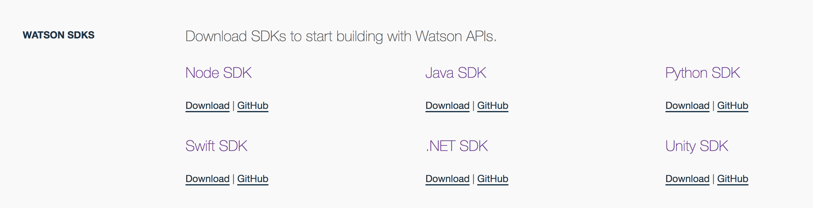
Bibliotecas
https://www.ibm.com/watson/developercloud/developer-tools.html

Slide 32
Bibliotecas - NodeJS
Repositório NPM:
https://www.npmjs.com/package/watson-developer-cloud
GitHub:
https://github.com/watson-developer-cloud/node-sdk
Instalação
npm install --save watson-developer-cloud

Slide 33
Bibliotecas – NodeJS - REST
var SpeechToTextV1 = require('watson-developer-cloud/speech-to-text/v1');
var fs = require('fs');
var speech_to_text = new SpeechToTextV1 ({
username: '{username}',
password: '{password}'});
var files = ['audio-file1.flac', 'audio-file2.flac'];
for (var file in files) {
var params = {
audio: fs.createReadStream(files[file]),
content_type: 'audio/flac',
timestamps: true,
word_alternatives_threshold: 0.9,
keywords: ['colorado', 'tornado', 'tornadoes'],
keywords_threshold: 0.5
};
speech_to_text.recognize(params, function(error, transcript) {
if (error)
console.log('Error:', error);
else
console.log(JSON.stringify(transcript, null, 2));
});}

Slide 34
Bibliotecas – NodeJS - WebSocket
var SpeechToTextV1 = require('watson-developer-cloud/speech-to-text/v1');
var fs = require('fs');
var speech_to_text = new SpeechToTextV1 ({
username: '{username}',
password: '{password}'
});
var params = {
model: 'en-US_BroadbandModel',
content_type: 'audio/flac',
'interim_results': true,
'max_alternatives': 3,
'word_confidence': false,
timestamps: false,
keywords: ['colorado', 'tornado', 'tornadoes'],
'keywords_threshold': 0.5
};
// Create the stream.
var recognizeStream = speech_to_text.createRecognizeStream(params);

Slide 35
Bibliotecas – NodeJS - WebSocket
// Pipe in the audio.
fs.createReadStream('audio-file.flac').pipe(recognizeStream);
// Pipe out the transcription to a file.
recognizeStream.pipe(fs.createWriteStream('transcription.txt'));
// Get strings instead of buffers from 'data' events.
recognizeStream.setEncoding('utf8');
// Listen for events.
recognizeStream.on('results', function(event) { onEvent('Results:', event); });
recognizeStream.on('data', function(event) { onEvent('Data:', event); });
recognizeStream.on('error', function(event) { onEvent('Error:', event); });
recognizeStream.on('close', function(event) { onEvent('Close:', event); });
recognizeStream.on('speaker_labels', function(event) { onEvent('Speaker_Labels:', event); });
// Displays events on the console.
function onEvent(name, event) {
console.log(name, JSON.stringify(event, null, 2));
};

Slide 36
Bibliotecas - NodeJS
Projetos Exemplo:
Chamadas síncronas (REST):
https://github.com/hackatruck/stt-rest-nodejs
Usando Websocket:
https://github.com/hackatruck/stt-websocket-nodejs

Slide 37
Bibliotecas - Swift
GitHub:
https://github.com/watson-developer-cloud/swift-sdk

Slide 38
Bibliotecas - Swift
Instalação:
$ brew update
$ brew install carthage
Crie um arquivo Cartfile na raiz do projeto (onde está o .xcodeProject) contendo ‘github "watson-developer-cloud/swift-sdk”’
$ echo 'github "watson-developer-cloud/swift-sdk"' > Cartfile
Execute
$ carthage update --platform iOS

Slide 39
Bibliotecas - Swift
import SpeechToTextV1
let username = "your-username-here"
let password = "your-password-here"
let speechToText = SpeechToText(username: username, password: password)
func startStreaming() {
var settings = RecognitionSettings(contentType: .opus)
settings.continuous = true
settings.interimResults = true
let failure = { (error: Error) in print(error) }
speechToText.recognizeMicrophone(settings: settings, failure: failure) { results in
print(results.bestTranscript)
}
}
func stopStreaming() {
speechToText.stopRecognizeMicrophone()
}

Slide 40
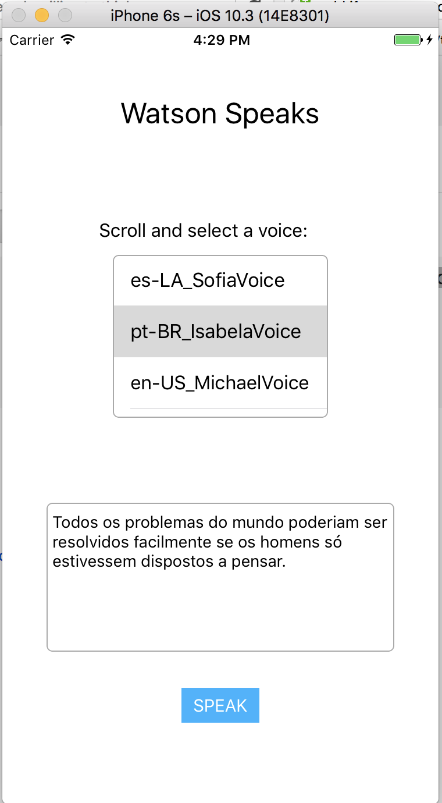
Bibliotecas - Swift
Projeto Exemplo:
https://github.com/watson-developer-cloud/speech-to-text-swift

Slide 41
Bibliotecas – Node Red
Exemplos de fluxo em: https://github.com/hackatruck/NodeRed

Slide 42
Exercícios:
Experimentar a aplicação Node Red
Experimentar a aplicação NodeJS
Experimentar a aplicação Swift
Criar um modelo customizado usando NodeRed/NodeJS/Swift
Fazer as aplicações NodeRed/NodeJS/Swift utilizarem o modelo customizado

